Slide 1


Data Analysis: Project Budget to Actual
Excel worksheet link: https://1drv.ms/x/s!Ag8NYJ8KNFj8hXAgqY_8T8W0gb7-
Abbreviations used:
BH – Budget Hours
AH – Actual Hours
BC – Budget Costs
AC – Actual Costs
Submission by Yash Brahmankar

Slide 2
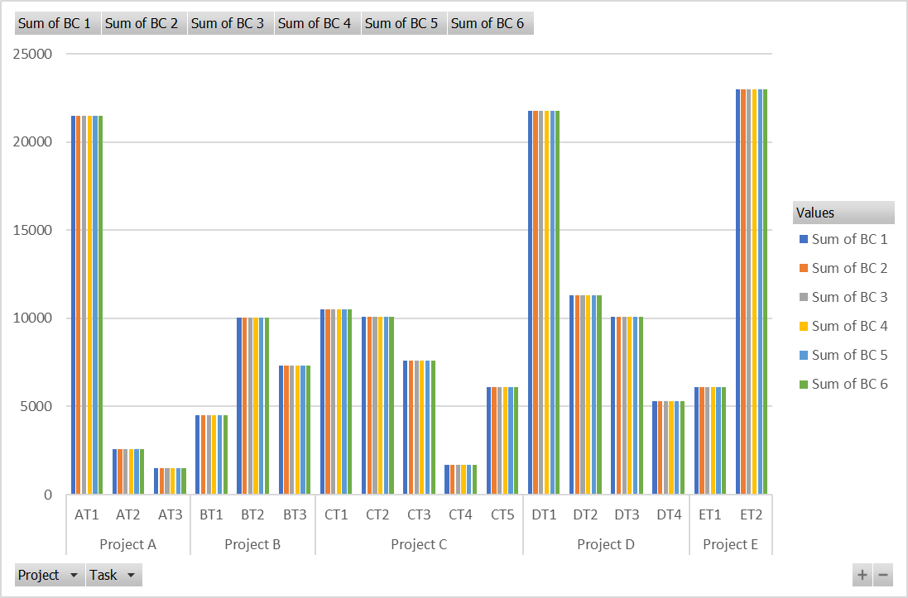
Observation or data here…
This chart gives a detailed view of the total Budgeted Costs, over the 6 months, of the various tasks under each project.
ET2 was allotted the highest budget.
AT3 was allotted the lowest budget.

Slide 3
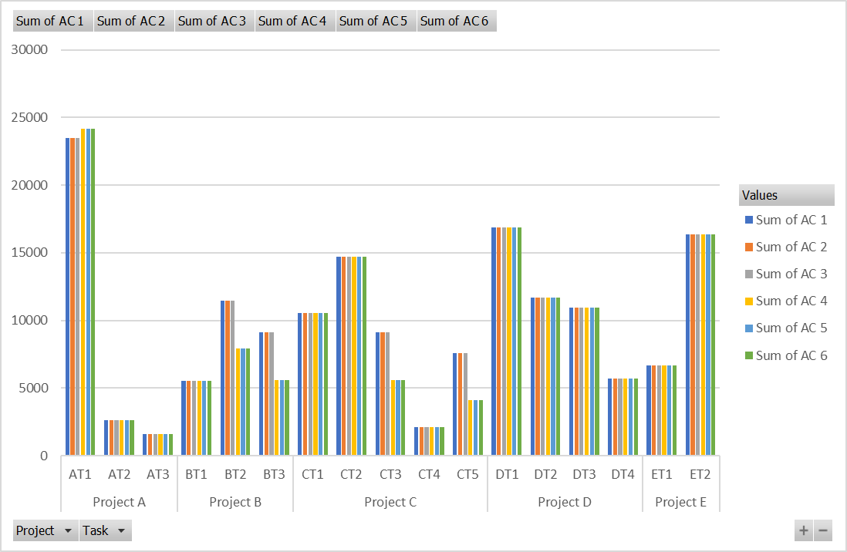
Observation or data here…
This chart gives a detailed view of the total Actual Costs, over the 6 months, of the various tasks under each project.
Highest amount was spent on AT1.
Lowest amount was spent on AT3.

Slide 4
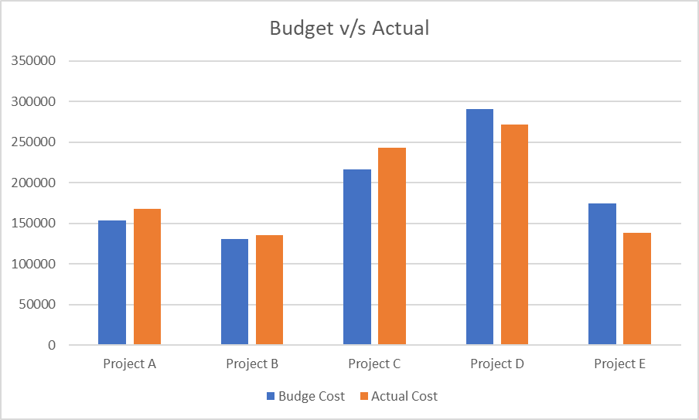
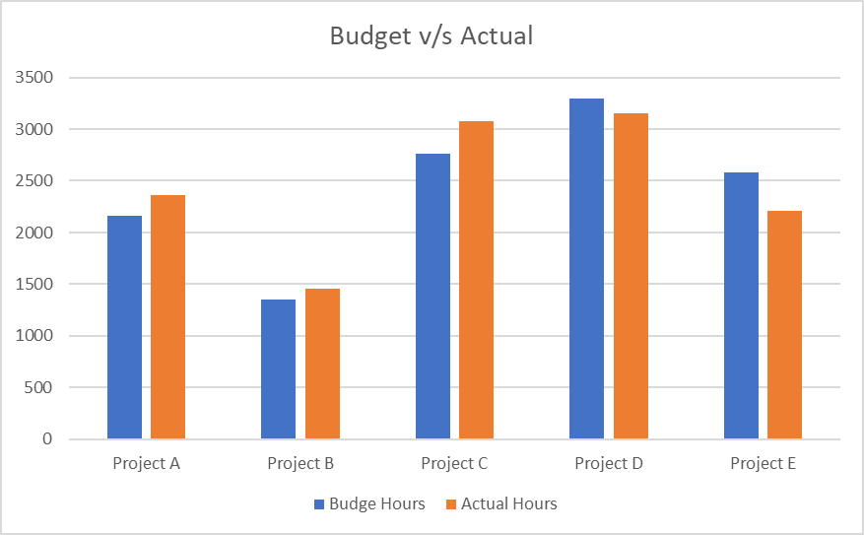
Observation or data here…
This chart shows the comparison between Budgeted and Actual costs for all 5 projects.
Projects A, B, and C are over the budgeted costs.
Projects D and E are under the budgeted costs.
This chart shows the comparison between Budgeted and Actual hours for all 5 projects.
Projects A, B, and C are under the budgeted number of hours.
Projects D and E are under the budgeted number of hours.

Slide 5
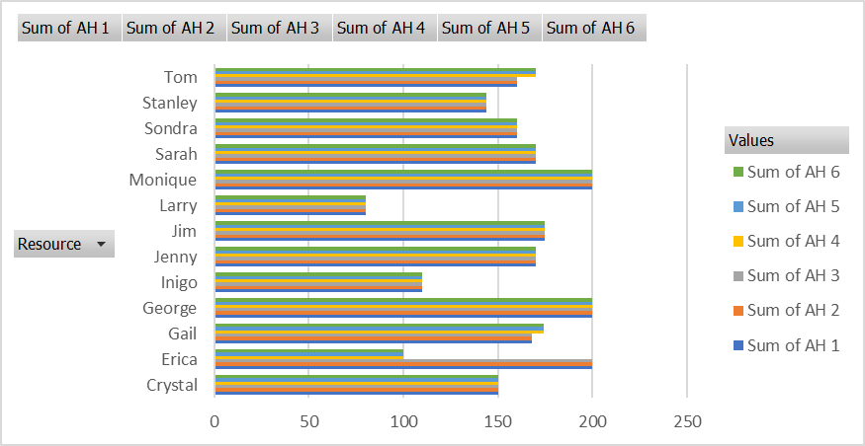
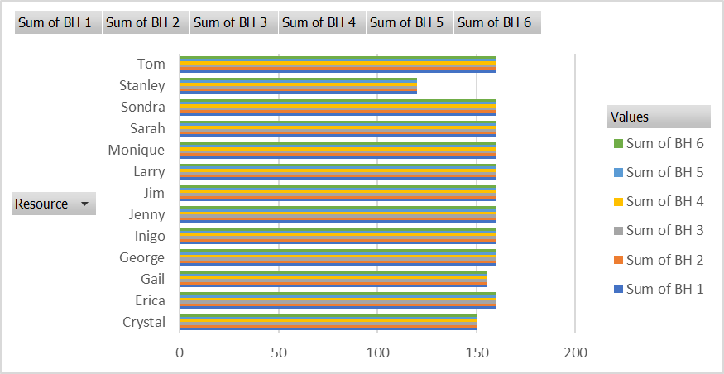
Observation or data here…
These two charts give us a comparison between the budgeted and actual hours required by each resource over the period of the project (6 months).

Slide 6
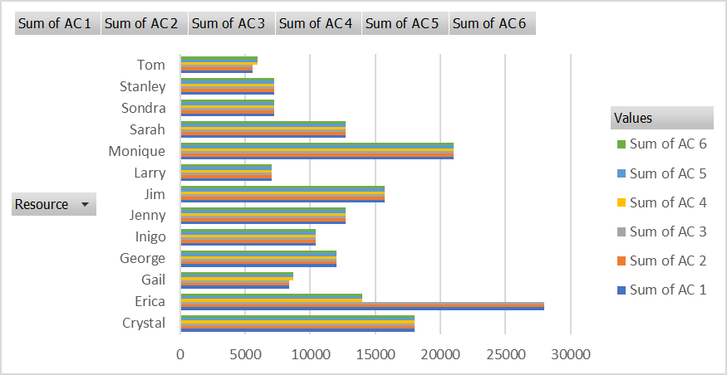
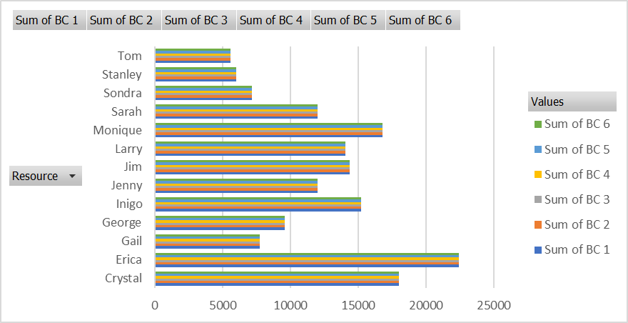
Observation or data here…
These two charts give us a comparison between the budgeted and actual costs charged by each resource over the period of the project (6 months).

Slide 7
Observations and Key Insights
ET2 was allotted the highest budget.
AT3 was allotted the lowest budget.
Highest amount was spent on AT1.
Lowest amount was spent on AT3.
Projects A, B, and C are over the budgeted costs.
Projects D and E are under the budgeted costs.
Projects A, B, and C are under the budgeted number of hours.
Projects D and E are under the budgeted number of hours.
Erica was allotted the highest amount of budget cost.
The highest amount was actually spent on Erica and Monique.
Stanley was supposed to work for the least number of hours.
Actually, Larry worked for the least number of hours.
.
.
and so on…
Many such useful insights can be noted from the tables and charts plotted in the worksheet using the given data.

